Slide 1
Question 223.15.3
You are building a camera with refractive lenses. Would you expect all colors of light to focus at the same point?
Yes
No
Can’t tell

Slide 2
Question 223.15.4
What type of lens is a simple magnifier?
Convex
Concave
Diverging
Converging
More than one of the above

Slide 3
Question 223.15.6
A
f
f
f
f
B
f
f
A ray enters a lens as shown above. Which of the choices to the right shows how the ray will exit the lens?
C
f
f

Slide 4
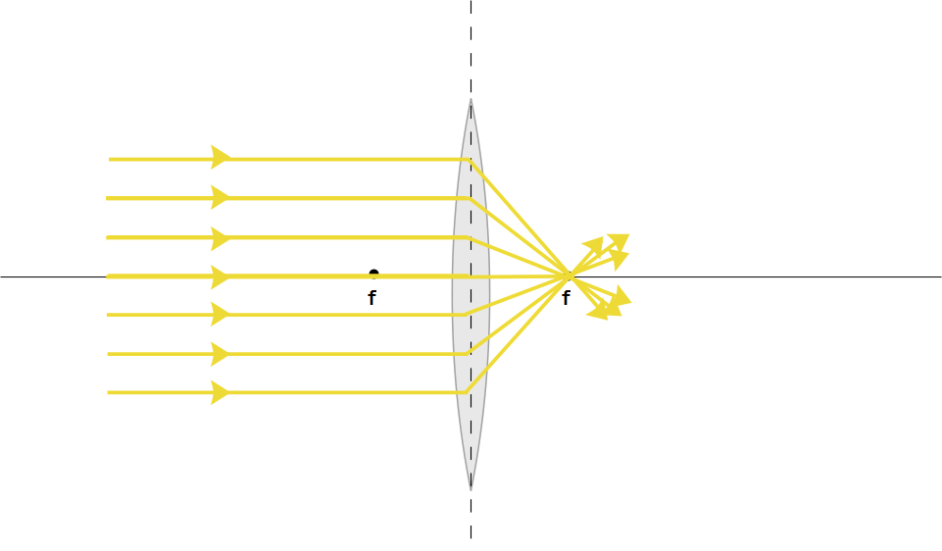

Slide 5
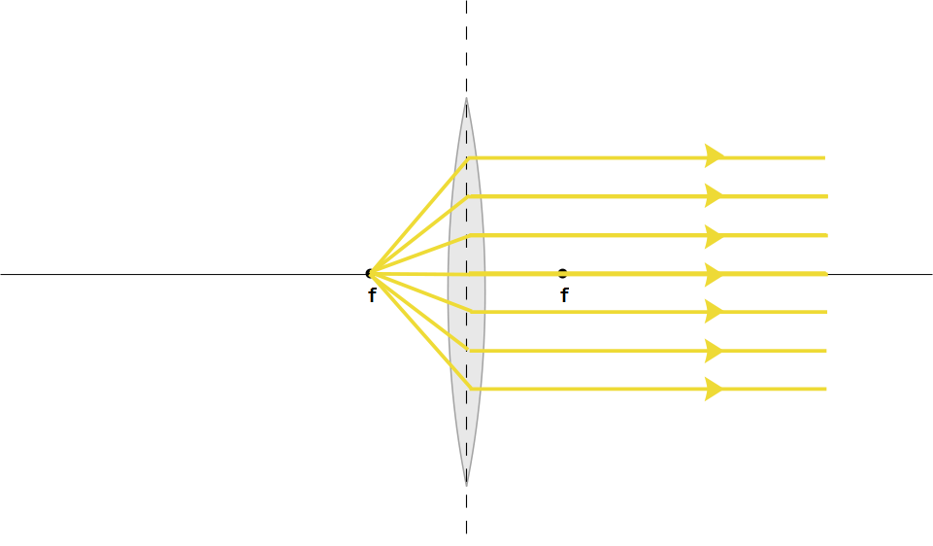

Slide 7
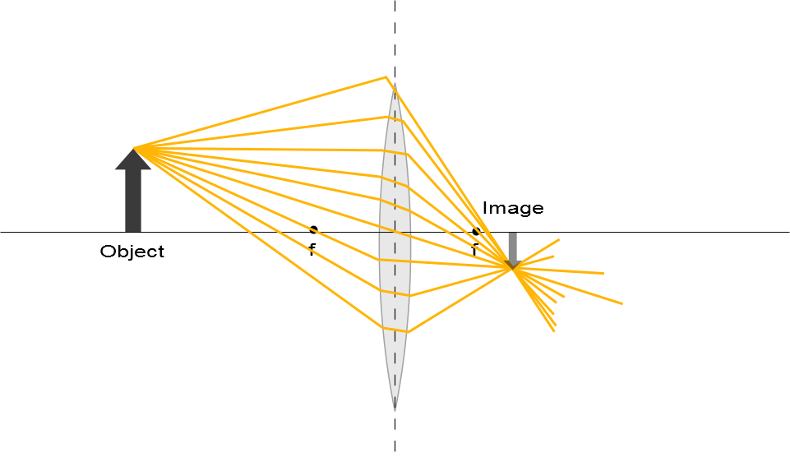

Slide 8
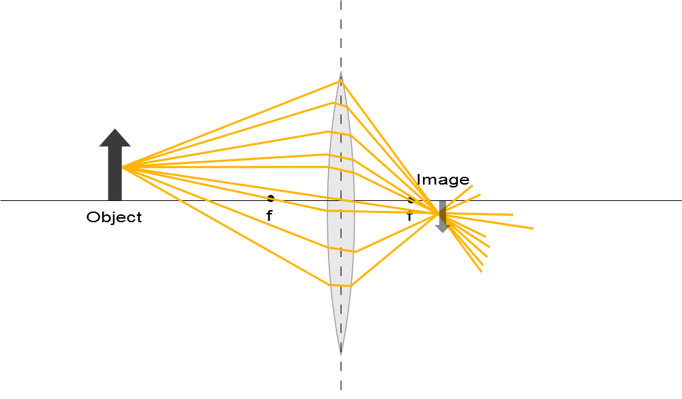

Slide 10
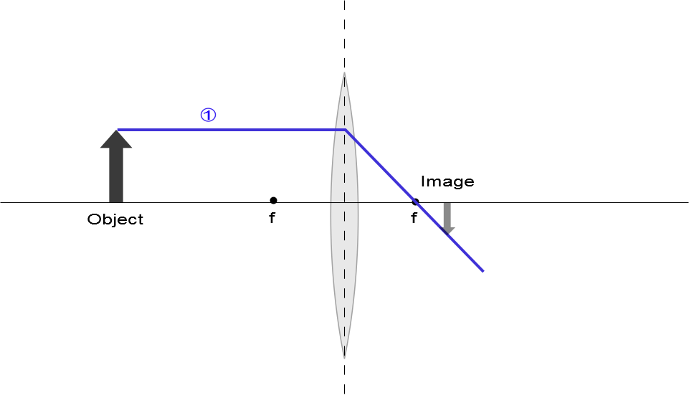

Slide 11
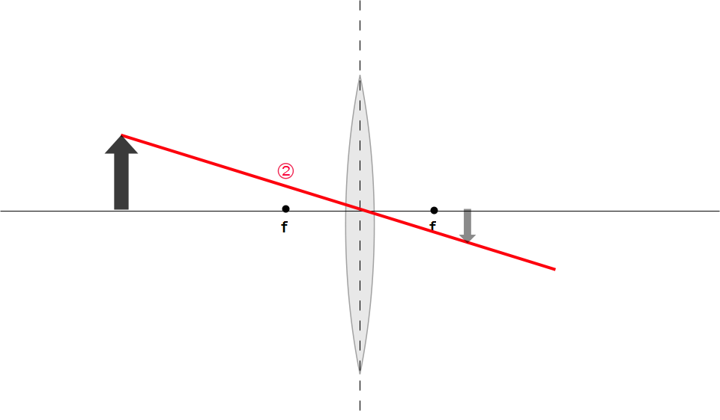
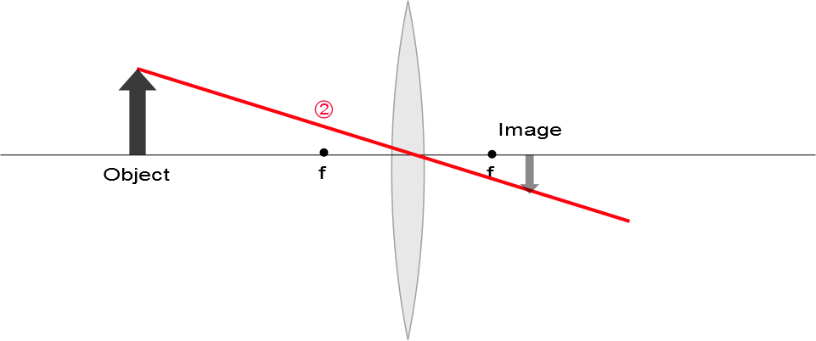

Slide 12
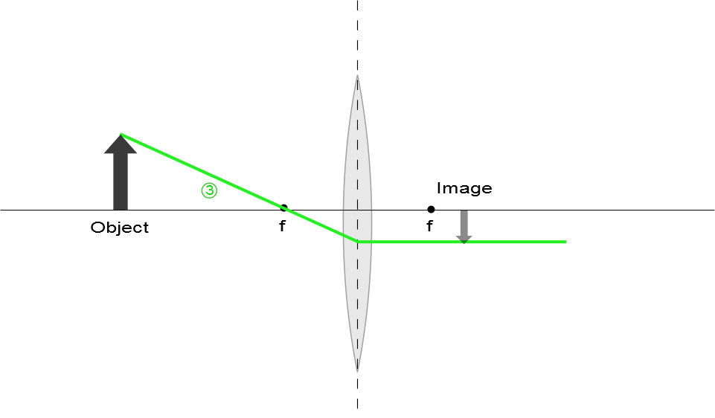

Slide 13
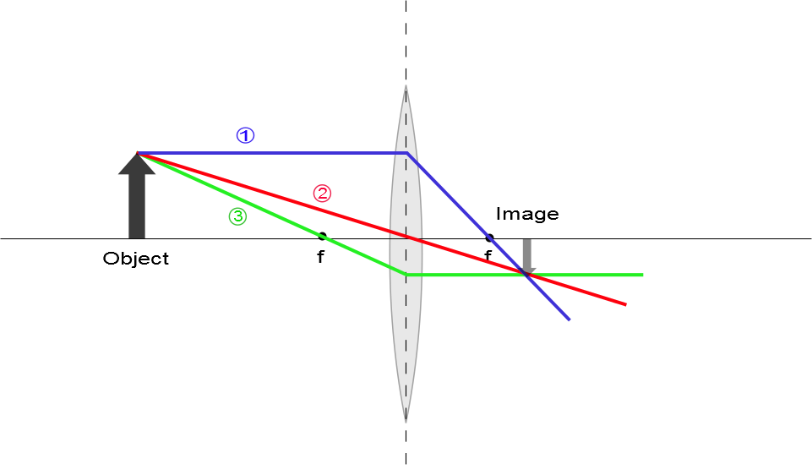
Ray Diagram for Converging Lens, s > f
The image is real
The image is inverted
The image is on the back side of the lens

Slide 14
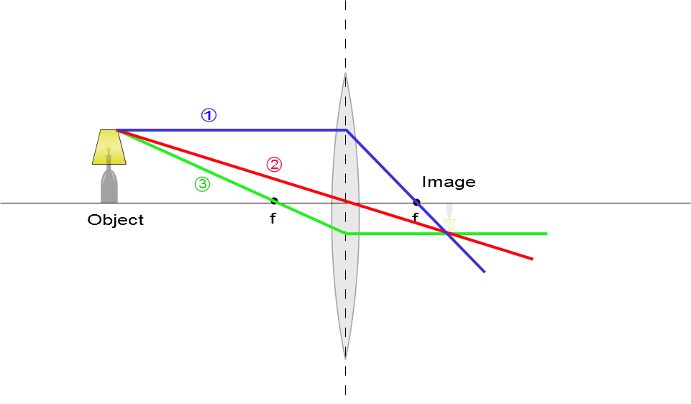
Ray Diagram for Converging Lens, s > f
The image is real
The image is inverted
The image is on the back side of the lens

Slide 15
Question 223.15.7
A
f
f
f
f
B
f
f
A ray enters a lens as shown above. Which of the choices to the right shows how the ray will exit the lens?
C
f
f

Slide 16
Question 223.15.8
A
f
f
f
f
B
f
f
A ray enters a lens as shown above. Which of the choices to the right shows how the ray will exit the lens?
C
f
f

Slide 17
Question 223.15.9
A
f
f
f
f
B
f
f
A ray enters a lens as shown above. Which of the choices to the right shows how the ray will exit the lens?
C
f
f

Slide 18
Question 223.15.10
A
f
f
f
f
B
f
f
A ray enters a lens as shown above. Which of the choices to the right shows how the ray will exit the lens?
C
f
f

Slide 19
Question 223.15.11
A
f
f
f
f
B
f
f
A ray enters a lens as shown above. Which of the choices to the right shows how the ray will exit the lens?
C
f
f

Slide 20
Question 223.15.12
A
f
f
f
f
B
f
f
A ray enters a lens as shown above. Which of the choices to the right shows how the ray will exit the lens?
C
f
f

Slide 21
Question 223.15.13
A
f
f
f
f
B
f
f
A ray enters a lens as shown above. Which of the choices to the right shows how the ray will exit the lens?
C
f
f

Slide 22
Question 223.15.13
A
f
f
f
f
B
f
f
A ray enters a lens as shown above. Which of the choices to the right shows how the ray will exit the lens?
C
f
f

Slide 23
Question 223.15.14
Three rays leave a glowing object and pass through a lens as shown. After passing through the lens, where do they meet?
At f
At the center of the lens
This is silly, they don’t meet anywhere
f
f

Slide 24
Question 223.15.15
Three rays leave a glowing object and pass through a lens as shown. After passing through the lens, where does our brain think they meet?
At f
At the center of the lens
Somewhere behind the lens off to the left
f
f

Slide 25
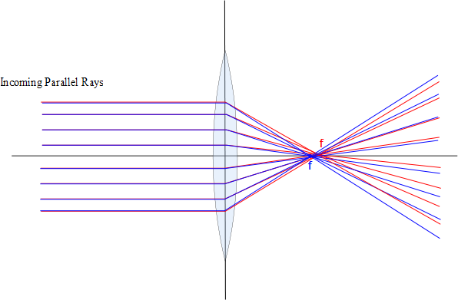

Slide 26
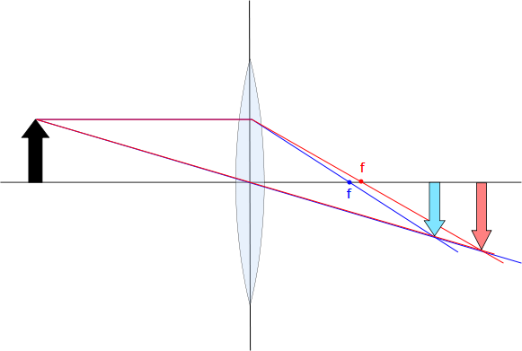

Slide 27
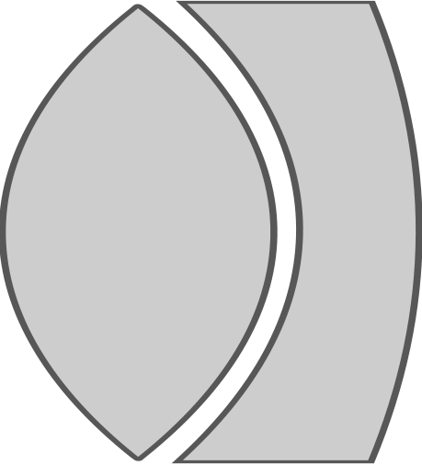


Slide 28
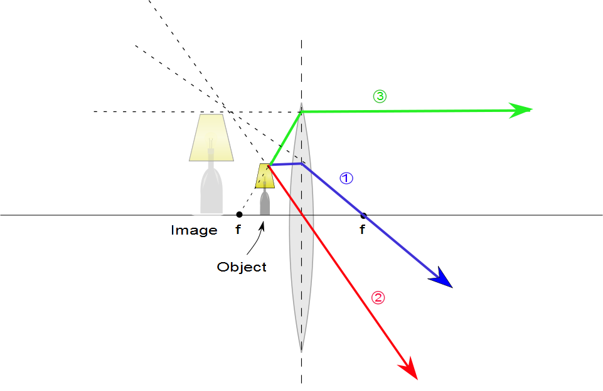
Ray Diagram for Converging Lens, p < f
The image is virtual
The image is upright
The image is larger than the object
The image is on the front side of the lens

Slide 29
Ray Diagrams for Thin Lenses – Diverging
For a diverging lens, the following three rays are drawn:
Ray 1 is drawn parallel to the principal axis and emerges directed away from the focal point on the front side of the lens
Ray 2 is drawn through the center of the lens and continues in a straight line
Ray 3 is drawn in the direction toward the focal point on the back side of the lens and emerges from the lens parallel to the principal axis

Slide 30
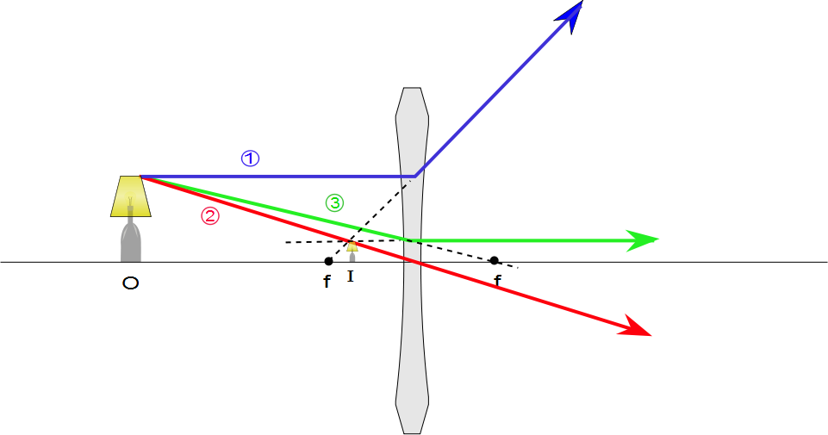
Ray Diagram for Diverging Lens
The image is virtual
The image is upright
The image is smaller
The image is on the front side of the lens

Slide 31
Object
[Figure]
Convergence Point

Slide 32
A
θ₁
θ₂
η
S
d
ψ
α
β
γ
P
V
C
R
s
s’

Slide 33
Sign Convention

Slide 34
Front
Back
Object
[Figure]
Convergence Point

Slide 35
s
s’
Rays from fish
Fish in water
ℓ
Image of Fish
θ₂
θ₁
ℓ
θ₁
θ₂
Rays appear to come from here
n₁ (Large)
n₂ (Small)

Slide 36
Question 223.16.1
What is the focal length of a pane of window glass?
zero
infinity
the thickness of the glass
impossible to determine

Slide 37
Derivation of the Lens Equ.
B
A
C₁
C₂
P
S
n
t
R₂
s₁
s’₂
R₁

Slide 38
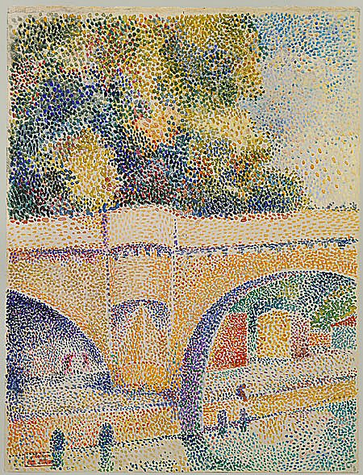

Slide 39
Derivation of the Lens Equ.
B
A
C₁
C₂
P
S
n
t
R₂
s₁
s’₂
R₁

Slide 40
Derivation of the Lens Equ.
A
P₁
C₁
S
n
S’₁
s₁
R₁

Slide 41
Derivation of the Lens Equ.
B
A
A
C₁
P₁
C₁
C₂
P₂
S
n
R₂
S’₁
s’₂
t
s₂

Slide 42
Derivation of the Lens Equ.
B
A
C₁
C₂
P
S
n
t
R₂
s₁
S’₂
R₁

Slide 43
Derivation of the Lens Equ.
R₁
S
C₂
n
C₁
P
R₂
s
s’

Slide 44
P₃
P₂
P₁
S₁
S₂
S₃
S
S’

Slide 46
Question 223.16.2
If the image is on the same side of the air-glass interface as the object, we call this a virtual image. What would be the sign of the image distance, s’?
Positive
Negative
Neutral

Slide 47
Question 223.16.3
If the image inverted, what is the sign of the image height?
Positive
Negative
Neutral

Slide 48
Question 223.16.4
If the image is inverted, what is the sign of the magnification?
Positive
Negative
Neutral

Slide 49
Question 223.16.5
What would
Be for a thin lens?
The radius ratio
The lens thickness
The lens width
The focal length

Slide 50
Question 223.16.6
The professor tells us that we will find the thin lens formula by making the image of a dot of light. This is OK because…
No one takes pictures of anything but dot’s of light
He is lazy and does not want to do anything bigger than a dot
A dot of light images into a complete picture, like the Mona Lisa
We can think about any extended body as consisting of emitting or reflecting dots.

Slide 51
Derivation of the Lens Equ.
Front
Back
R₁
S
C₂
n
C₁
P
R₂
s
s’

Slide 52
h
θ
I
O
n
θ
h’
s
s’

